Slide 1
The Traveling Janitor
Team MAV
McKenna Galle
Andrew Hutson
Vina Le
17FA CS473
Advanced Algorithm, Design, and Analysis

Slide 2
Our Inspiration
Our different leg spans.
Something that is beneficial towards campus and the students.
Originally: implemented for students finding the shortest path between each academic building.
Modified: implemented for Whitworth’s facilities department to find the shortest route around all buildings .

Slide 3
The Program
Used The Travelling Salesman algorithm that finds the shortest path.
Data is measured by finding the distance each group member can walk in one minute.
Uses a distance-tracking map to calculate distances from each building - measured in feet.
Hand-entry of distances between buildings as weighted graph edges.

Slide 4
The Program
Used the Branch-And-Bound algorithm to find the shortest route around campus.
Uses a global variable to create a convex-Boolean optimization for faster computations.
Hand-entry of distances between buildings as weighted graph edges.
Is non-heuristic with a provided lower and upper bound.
Continues until all bounds are worse than or equal to the bounds.

Slide 5
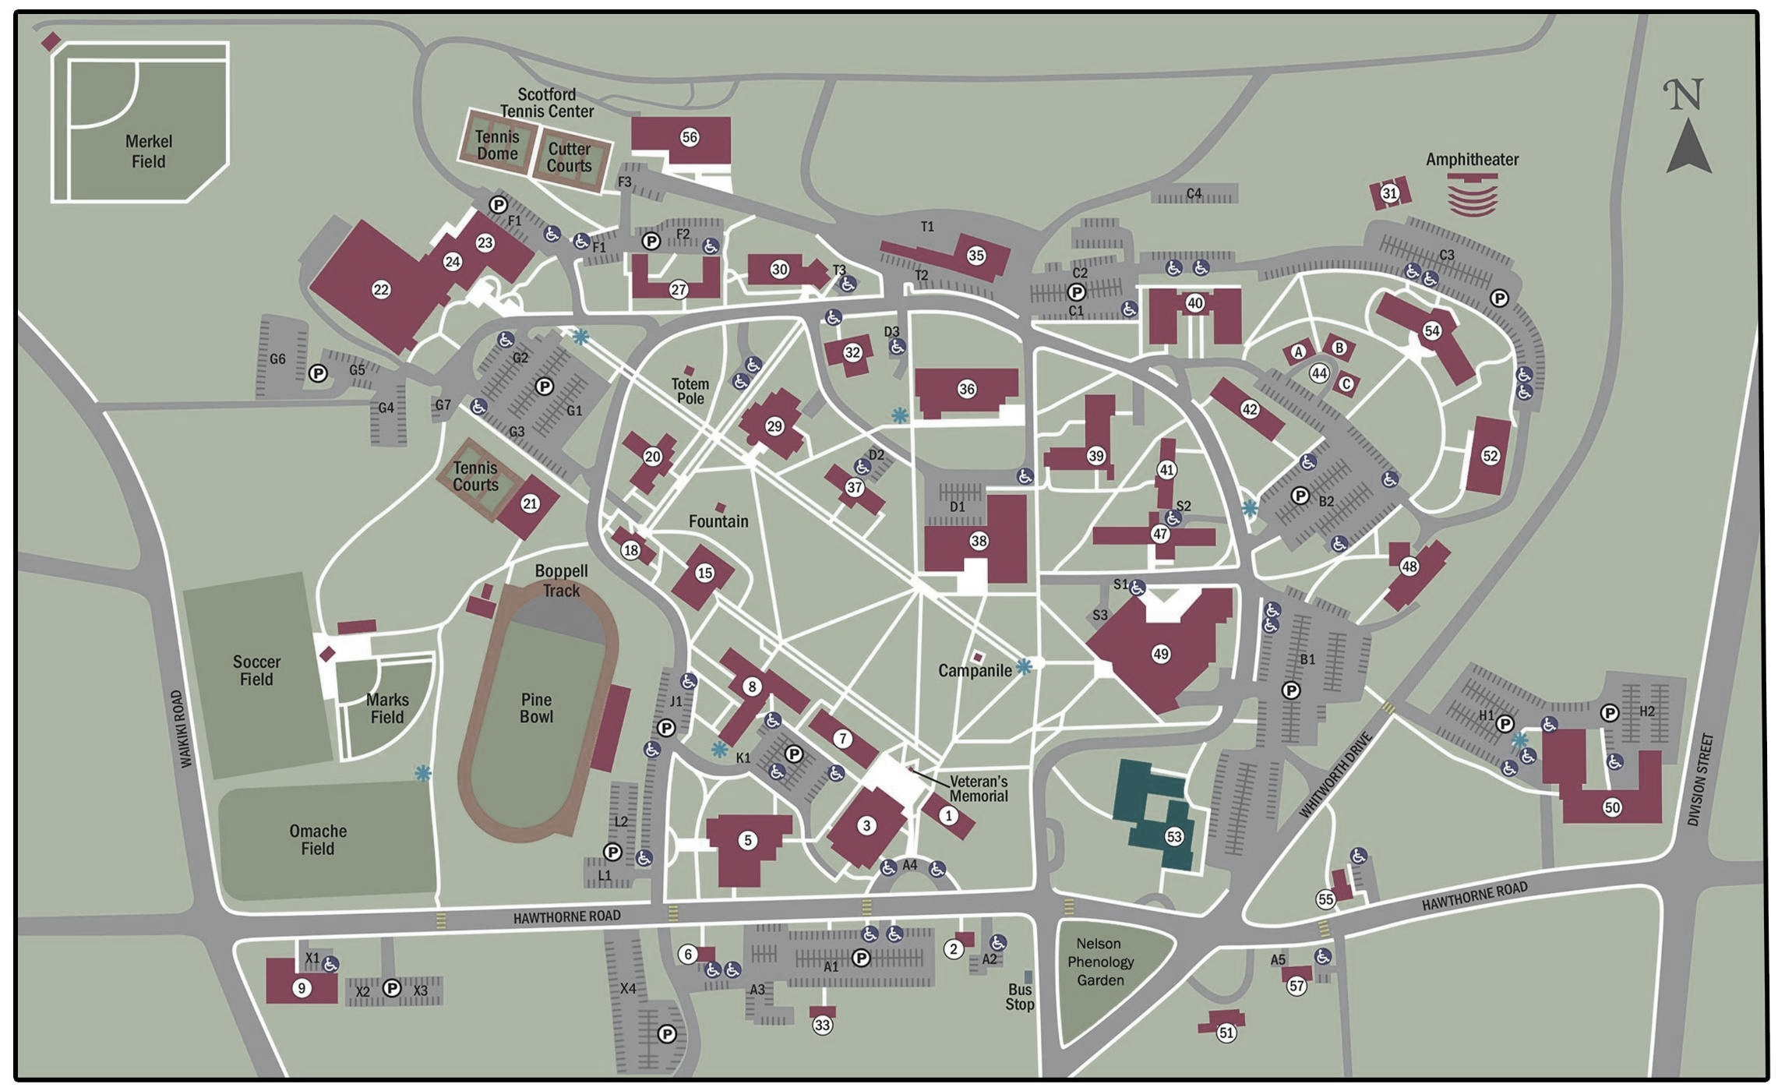
Our Design

Slide 6
Greedy

Slide 7
Branch-And-Bound

Slide 8
Mathematical Analysis
Basic Algorithm: The Travelling Salesman used to find the most efficient route between each building on Whitworth’s campus.
There exist 13 academic classroom-based buildings on campus.
There’s 14! possibilities for facilities to go to at any given time.
Recursion : n*2^{n}
Used for the if statements found in our main function
Includes a for-loop that executes n times
WORST CASE: Branch-And-Bound always ends with 2^{n} problems

Slide 9
Mathematical Analysis
Worst Case: Branch-And-Bound always ends with 2^{n} problems using exhaustive search
Branch-And-Bound algorithm
Eliminates nodes that are not possible
Searches for the most efficient path with a given lower and upper bound.

Slide 10
Theoretical Analysis
x = 0;
L₀ = {Q_{init}} ;
L₀ = Φ_{lb}(Q_{init}) ;
U₀ = Φ_{ub}(Q_{init}) ;
while U_{x}− L_{x} > Є ,
{
pick Q ∈ L_{x} such that Φ_{lb}(Q) = L_{x} ;
split Q along one of its longest edges into QI and QII ;
form L_{x}+1 from L_{x} by removing Q_{x} and adding QI and QII ;
L_{x} + 1 := minQ ∈ L_{x}+1 Φ_{lb}(Q) ;
U_{x}+ 1 := minQ∈L_{x}+1 Φ_{ub}(Q) ;
x := x + 1;
}
minimize f₀ (x , z )
subject to f_{i} (x , z ) ≤ 0, i = 1, . . . , m
z_{j} ∈ { 0, 1 }, j = 1, . . . , n
Where z_{j} , . . . , z_{j} are Boolean variables with z being the shortest route being picked.
Boolean variable: z ∈ { 0, 1 } ^{n} with each reduced points of x is convex
set L₁ = Φ_{lb}(Q_{init}) and U₁ = Φ_{ub}(Q_{init}) and terminate if U₁ − L₁ ≤ Є

Slide 11
Empirical Analysis
Originally started with 14 nodes
14! paths
Represents the buildings on campus
Computation took 30 milliseconds
Modified to 28
28! paths
Computation took 38 milliseconds
The time difference is 8 milliseconds.
Empirically, there were 87,178,291,200 possible paths for 14 nodes.
There is a ratio of 1.267 between data sets.
Approximately 26.7% increase in runtime.
Theoretically, there are 229,376 recursions in the Worst Case.
This is when the correct (shortest) path is found last.

Slide 12
Demonstration

Slide 13
Challenges
Pick an efficient algorithm
Dijkstra’s -> Greedy -> Dynamic
-> Branch-and-Bound
Keeping track of all possible outcomes.
Inputting everything in by hand

Slide 14
End Notes
Further improvements:
Add the dorms and the remaining buildings on campus.
Create an input and output data document.
Make project more generic – applicable for any campus.
Any questions or criticism will be welcomed.
Branch-And-Bound: https://web.stanford.edu/class/ee392o/bb.pdf
Kent’s B&B: https://goo.gl/HYh5FY - available on Blackboard
NOTE: All code-related sources are found in the code.

